Slide 1
AVL trees

Slide 2
AVL Trees
We have seen that all operations depend on the depth of the tree.
We don’t want trees with nodes which have large height
  This can be attained if both subtrees of each node have roughly the same height.
AVL tree is a binary search tree where the height of the two subtrees of a node differs by at most one
  Height of a null tree is -1

Slide 3
Balanced and unbalanced BST
1
4
2
2
5
3
1
3
4
4
Is this “balanced”?
5
2
6
6
1
3
5
7
7

Slide 4
Perfect Balance
Want a complete tree after every operation
  tree is full except possibly in the lower right
This is expensive
  For example, insert 2 in the tree on the left and then rebuild as a complete tree
6
5
Insert 2 &
complete tree
4
9
2
8
1
5
8
1
4
6
9

Slide 5
AVL - Good but not Perfect Balance
AVL trees are height-balanced binary search trees
Balance factor of a node
  height(left subtree) - height(right subtree)
An AVL tree has balance factor calculated at every node
  For every node, heights of left and right subtree can differ by no more than 1
  Store current heights in each node

Slide 6
Node Heights
Tree A (AVL)
Tree B (AVL)
height=2 BF=1-0=1
2
6
6
1
0
1
1
4
9
4
9
0
0
0
0
0
1
5
1
5
8
height of node = h
balance factor = h_{left}-h_{right}
empty height = -1

Slide 7
Node Heights after Insert 7
Tree A (AVL)
Tree B (not AVL)
2
3
balance factor
1-(-1) = 2
6
6
1
1
1
2
4
9
4
9
0
0
0
0
0
1
-1
1
5
7
1
5
8
0
7
height of node = h
balance factor = h_{left}-h_{right}
empty height = -1

Slide 8
Insert and Rotation in AVL Trees
Insert operation may cause balance factor to become 2 or –2 for some node
  only nodes on the path from insertion point to root node have possibly changed in height
  So after the Insert, go back up to the root node by node, updating heights
  If a new balance factor (the difference h_{left}-h_{right}) is 2 or –2, adjust tree by rotation around the node

Slide 9
Single Rotation in an AVL Tree
2
2
6
6
1
2
1
1
4
9
4
8
0
0
1
0
0
0
0
1
5
8
1
5
7
9
0
7

Slide 10
Insertions in AVL Trees
Let the node that needs rebalancing be α.
There are 4 cases:
Outside Cases (require single rotation) :
1. Insertion into left subtree of left child of α.
2. Insertion into right subtree of right child of α.
Inside Cases (require double rotation) :
3. Insertion into right subtree of left child of α.
4. Insertion into left subtree of right child of α.
The rebalancing is performed through four
separate rotation algorithms.

Slide 11
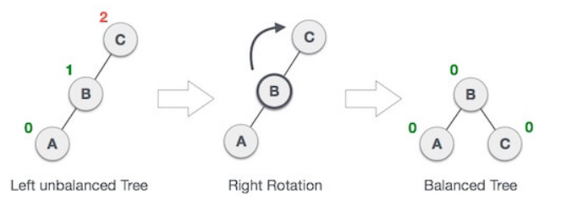
AVL Insertion: Outside Case
LL rotation: Inserted node is in the left subtree of left child of α
  When BST becomes unbalanced, due to a node is inserted into the left subtree of the left subtree of C, then we perform LL rotation, LL rotation is clockwise rotation, which is applied on the edge below a node having balance factor 2.

Slide 12
AVL Insertion: Outside Case
j
Consider a valid
AVL subtree
k
h
Z
h
h
X
Y

Slide 13
AVL Insertion: Outside Case
j
Inserting into X
destroys the AVL
property at node j
k
h
Z
h+1
h
Y
X

Slide 14
AVL Insertion: Outside Case
j
Do a “right rotation”
k
h
Z
h+1
h
Y
X

Slide 15
Single right rotation
j
Do a “right rotation”
k
h
Z
h+1
h
Y
X

Slide 16
Single right rotation
k
“Right rotation” done!
(“Left rotation” is mirror
symmetric)
j
h+1
h
h
X
Y
Z
AVL property has been restored!

Slide 17
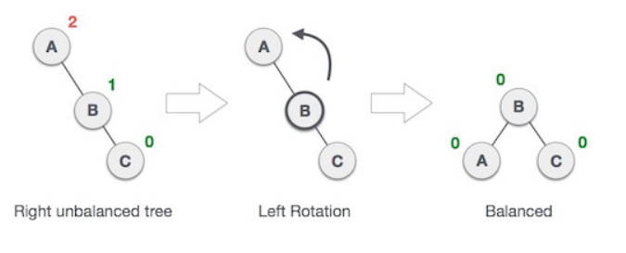
AVL Insertion: Outside Case
RR rotation: Inserted node is in the right subtree of right child of α
  When BST becomes unbalanced, due to a node is inserted into the right subtree of the right subtree of A, then we perform RR rotation, RR rotation is an anticlockwise rotation, which is applied on the edge below a node having balance factor -2

Slide 18
AVL Insertion: Inside Case
LR rotation : Inserted node is in the right subtree of left subtree of A
j
Consider a valid
AVL subtree
k
h
Z
h
h
X
Y

Slide 19
AVL Insertion: Inside Case
Inserting into Y
destroys the
AVL property
at node j
j
Does “right rotation”
restore balance?
k
h
Z
h
h+1
X
Y

Slide 20
AVL Insertion: Inside Case
k
“Right rotation”
does not restore
balance… now k is
out of balance
j
h
X
h
h+1
Z
Y

Slide 21
AVL Insertion: Inside Case
Consider the structure
of subtree Y…
j
k
h
Z
h
h+1
X
Y

Slide 22
AVL Insertion: Inside Case
j
Y = node i and
subtrees V and W
k
h
Z
i
h
h+1
X
h or h-1
V
W

Slide 23
AVL Insertion: Inside Case
j
We will do a left-right
“double rotation” . . .
k
Z
i
X
V
W

Slide 24
Double rotation : first rotation
j
left rotation complete
i
Z
k
W
V
X

Slide 25
Double rotation : second rotation
j
Now do a right rotation
i
Z
k
W
V
X

Slide 26
Double rotation : second rotation
right rotation complete
Balance has been
restored
i
k
j
h
h
h or h-1
V
X
W
Z

Slide 27
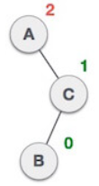

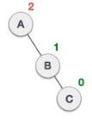

AVL Insertion: Inside Case
RL rotation : Insertion into left subtree of right child of α.

Slide 28
Implementation
balance (1,0,-1)
key
left
right
No need to keep the height; just the difference in height, i.e. the balance factor; this has to be modified on the path of insertion even if you don’t perform rotations
Once you have performed a rotation (single or double) you won’t need to go back up the tree

Slide 29
Insertion in AVL Trees
Insert at the leaf (as for all BST)
  only nodes on the path from insertion point to root node have possibly changed in height
  So after the Insert, go back up to the root node by node, updating heights
  If a new balance factor (the difference h_{left}-h_{right}) is 2 or –2, adjust tree by rotation around the node

Slide 30
Insert in AVL trees
Insert(T : reference tree pointer, x : element) : {
if T = null then
{T := new tree; T.data := x; height := 0; return;}
case
T.data = x : return ; //Duplicate do nothing
T.data > x : Insert(T.left, x);
if ((height(T.left)- height(T.right)) = 2){
if (T.left.data > x ) then //outside case
T = RotatefromLeft (T);
else //inside case
T = DoubleRotatefromLeft (T);}
T.data < x : Insert(T.right, x);
code similar to the left case
Endcase
T.height := max(height(T.left),height(T.right)) +1;
return;
}

Slide 31
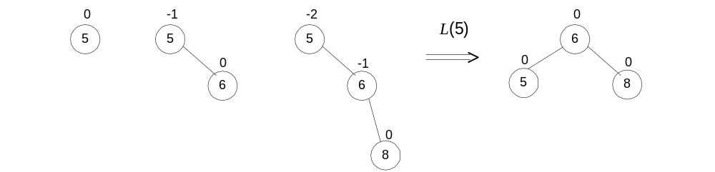
AVL Tree Construction: Example
Construct an AVL tree for the list 5, 6, 8, 3, 2, 4, 7

Slide 32
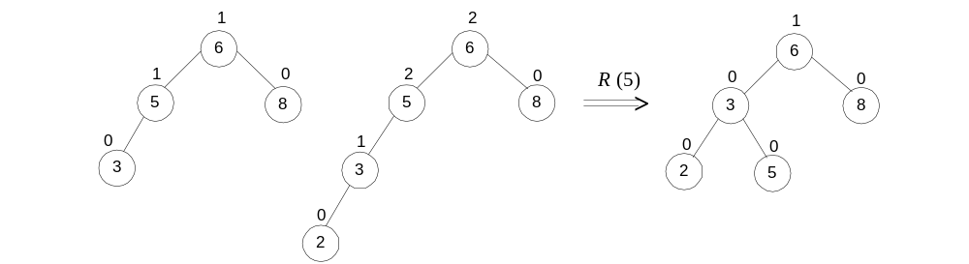
AVL Tree Construction: Example
Construct an AVL tree for the list 5, 6, 8, 3, 2, 4, 7

Slide 33
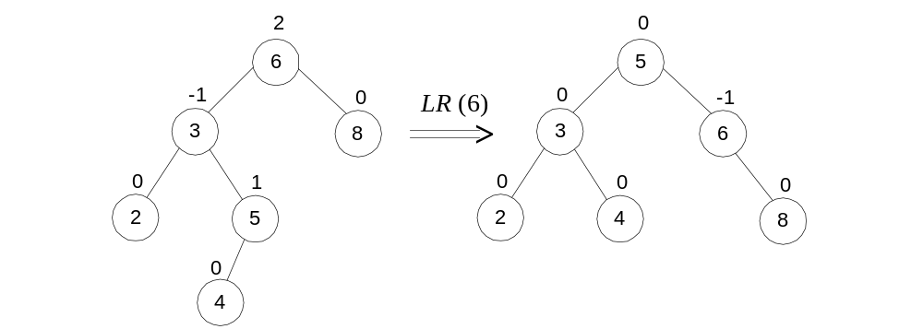
AVL Tree Construction: Example
Construct an AVL tree for the list 5, 6, 8, 3, 2, 4, 7

Slide 34
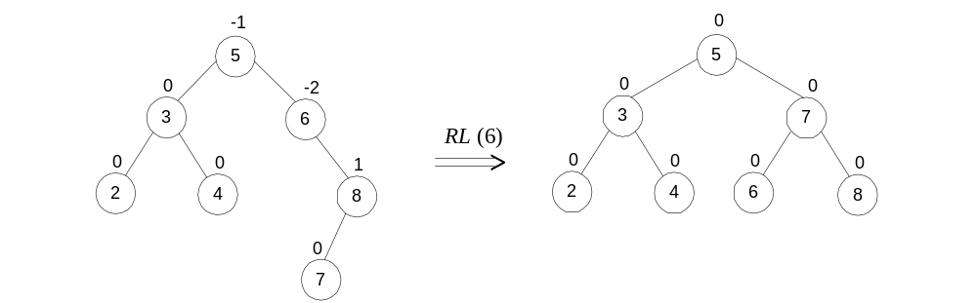
AVL Tree Construction: Example
Construct an AVL tree for the list 5, 6, 8, 3, 2, 4, 7

Slide 35
AVL Tree Deletion
Similar but more complex than insertion
  Rotations and double rotations needed to rebalance
  Imbalance may propagate upward so that many rotations may be needed.

Slide 36
Pros and Cons of AVL Trees
Arguments for AVL trees:
Search is O(log N) since AVL trees are always balanced.
Insertion and deletions are also O(logn)
The height balancing adds no more than a constant factor to the speed of insertion.
Arguments against using AVL trees:
Difficult to program & debug; more space for balance factor.
Asymptotically faster but rebalancing costs time.
Most large searches are done in database systems on disk and use other structures (e.g. B-trees).

